Slide 1
EMG Data Analysis

Slide 2
Information on Plots
Data Set Information:
Ref : http://archive.ics.uci.edu/ml/datasets/semg+for+basic+hand+movements
Instrumentation: The data were collected at a sampling rate of 500 Hz, using as a programming kernel the National Instrument’s (NI) Labview. The signals were band-pass filtered using a Butterworth Band Pass filter with low and high cutoff at 15Hz and 500Hz respectively and a notch filter at 50Hz to eliminate line interference artifacts. The hardware that was used was an NI analog/digital conversion card NI USB- 009, mounted on a PC. The signal was taken from two Differential EMG Sensors and the signals were transmitted to a 2-channel EMG system by Delsys Bagnoliâ Handheld EMG Systems. Protocol: The experiments consisted of freely and repeatedly grasping of different items, which were essential to conduct the hand movements. The speed and force were intentionally left to the subject’s will. There were two forearm surface EMG electrodes Flexor Capri Ulnaris and Extensor Capri Radialis, Longus and Brevis) held in place by elastic bands and the reference electrode in the middle, in order to gather information about the muscle activation. The subjects were asked to perform repeatedly the following six movements, which can be considered as daily hand grasps: a) Spherical: for holding spherical tools b) Tip: for holding small tools c) Palmar: for grasping with palm facing the object d) Lateral: for holding thin, flat objects e) Cylindrical: for holding cylindrical tools f) Hook: for supporting a heavy load Two different databases are included: 1) 5 healthy subjects (two males and three females) of the same age approximately (20 to 22-year-old) conducted the six grasps for 30 times each. The measured time is 6 sec. There is a mat file available for every subject. 2) 1 healthy subject (male, 22-year-old) conducted the six grasps for 100 times each for 3 consecutive days. The measured time is 5 sec. There is a mat file available for every day.

Slide 3
Single User Same Action Analysis
# Trials – 30
Trials plotted in below slides
Trial 1, 2, 15, 29,30

Slide 4
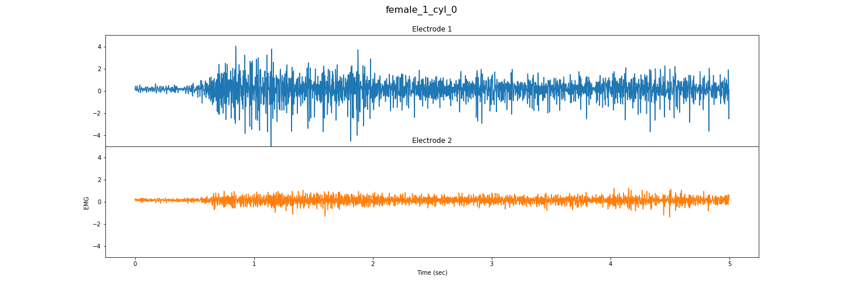
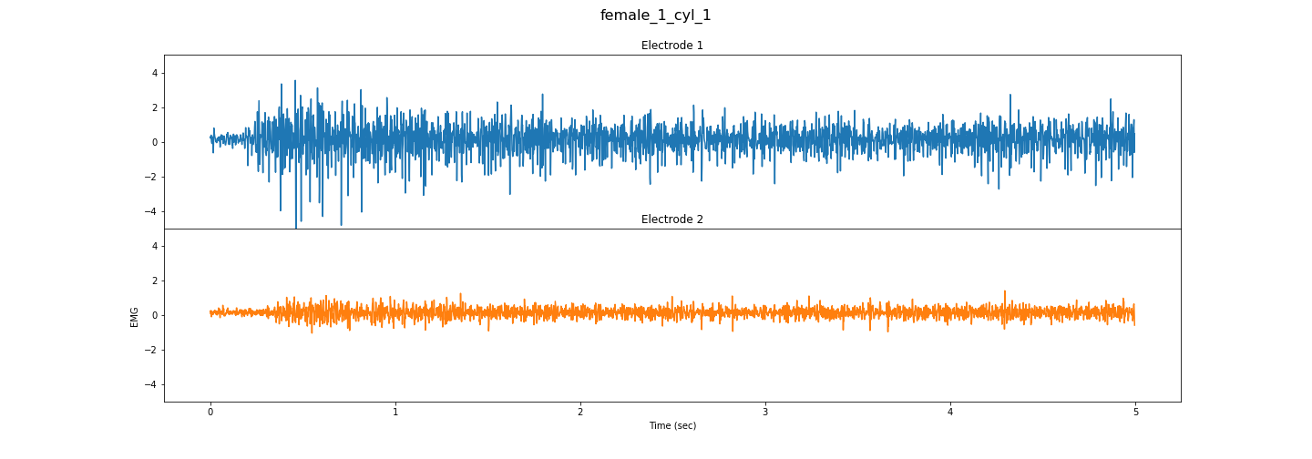
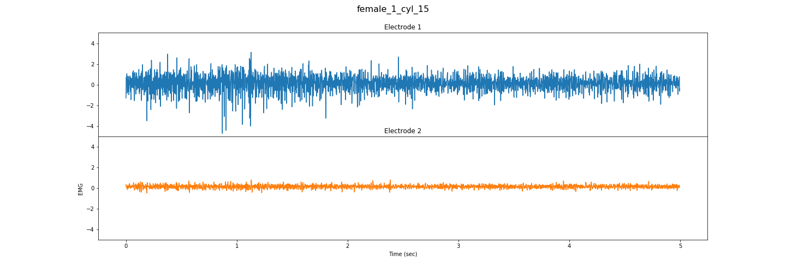
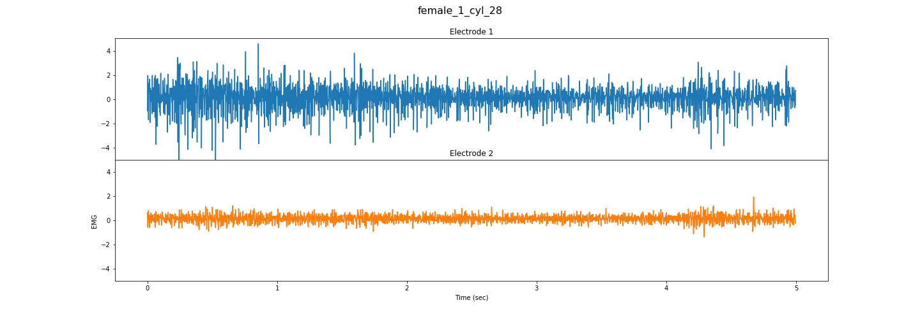
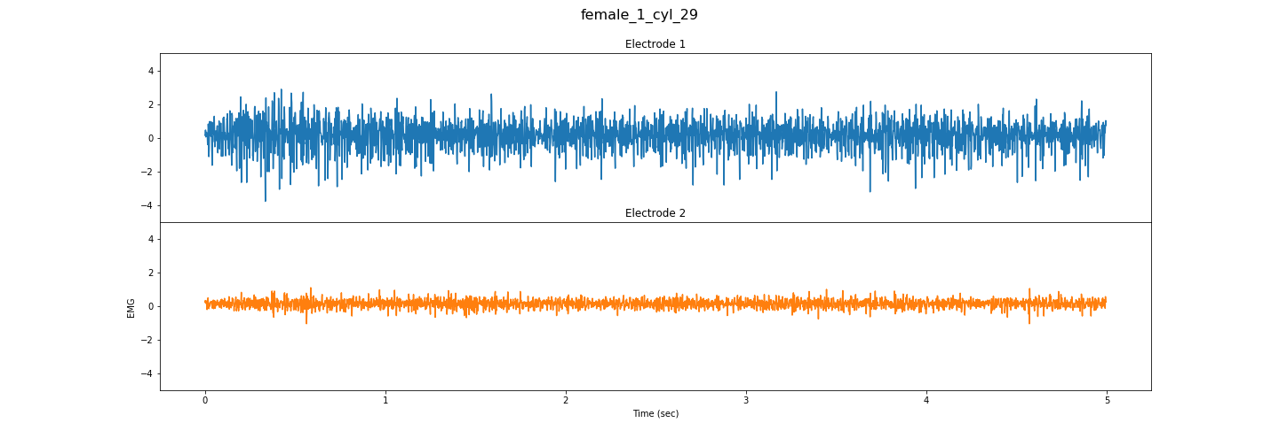

Slide 5
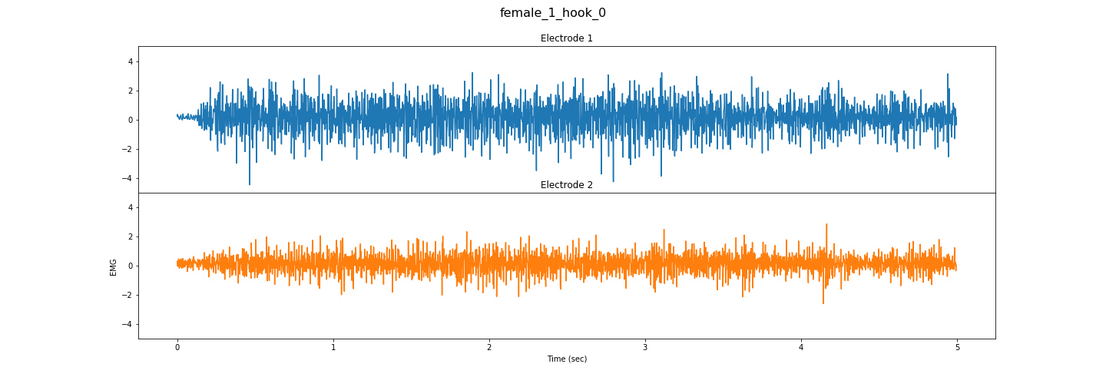
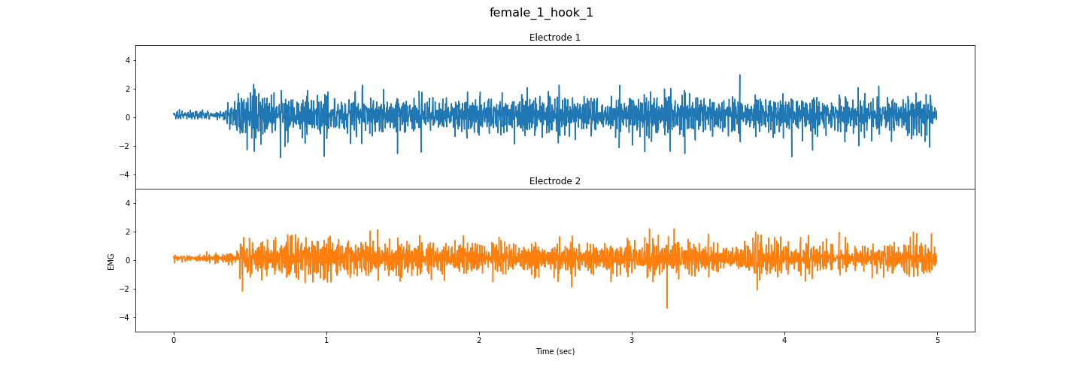
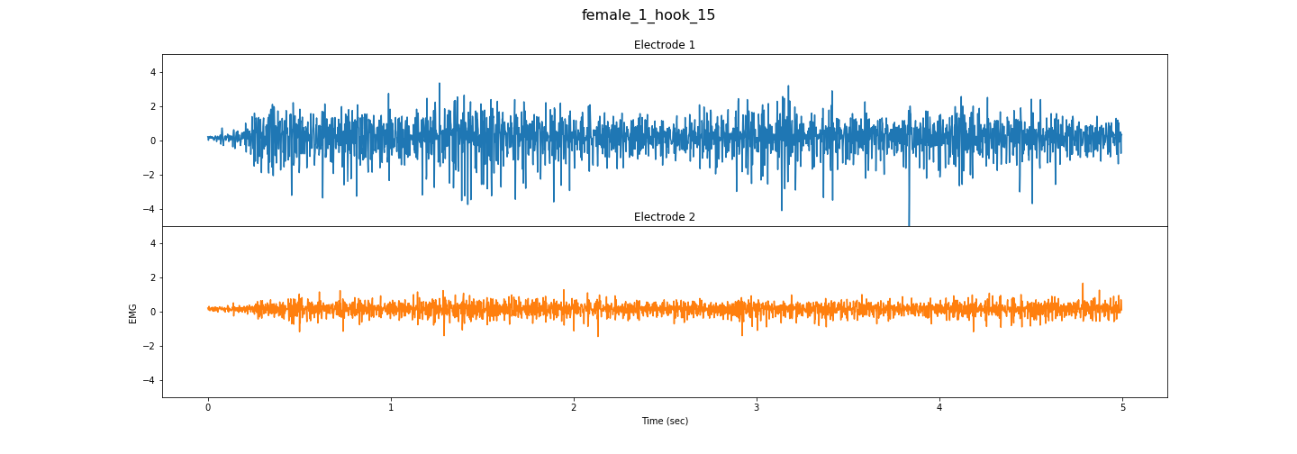
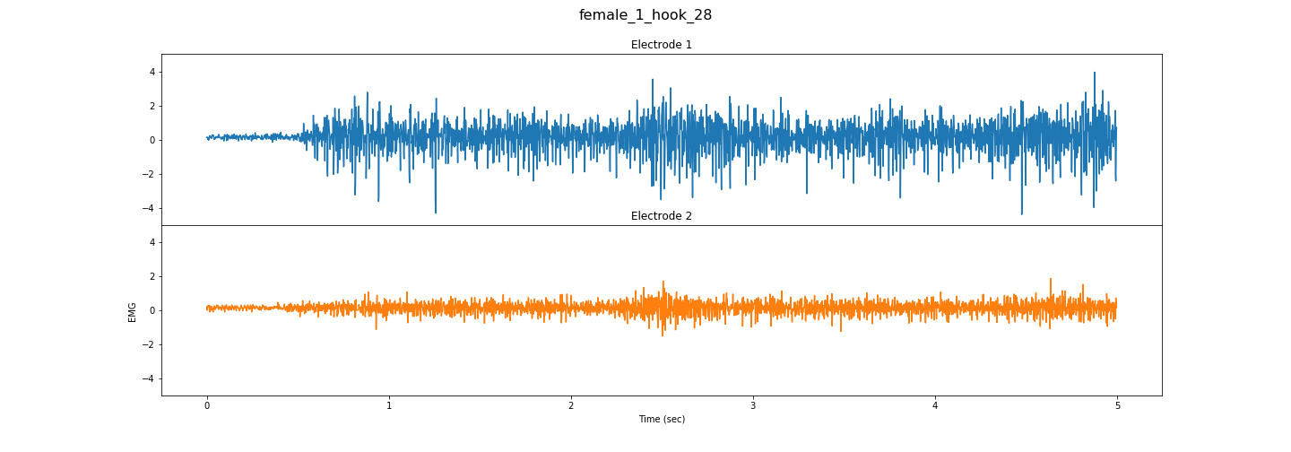
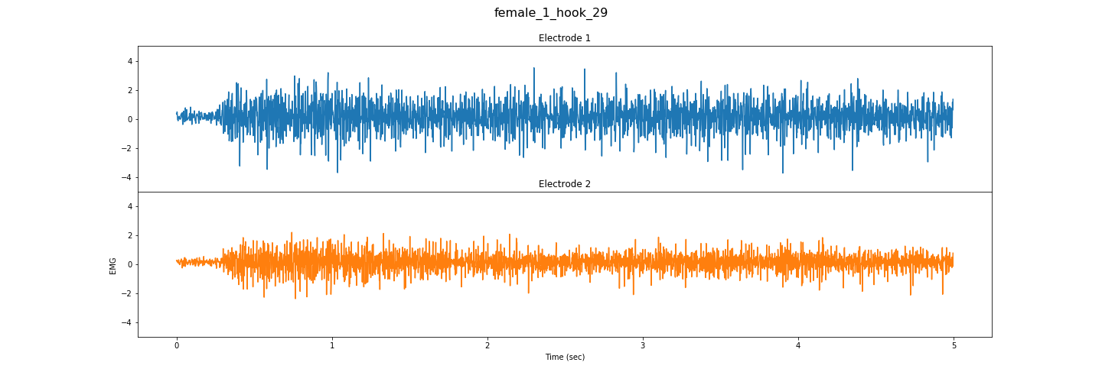

Slide 6
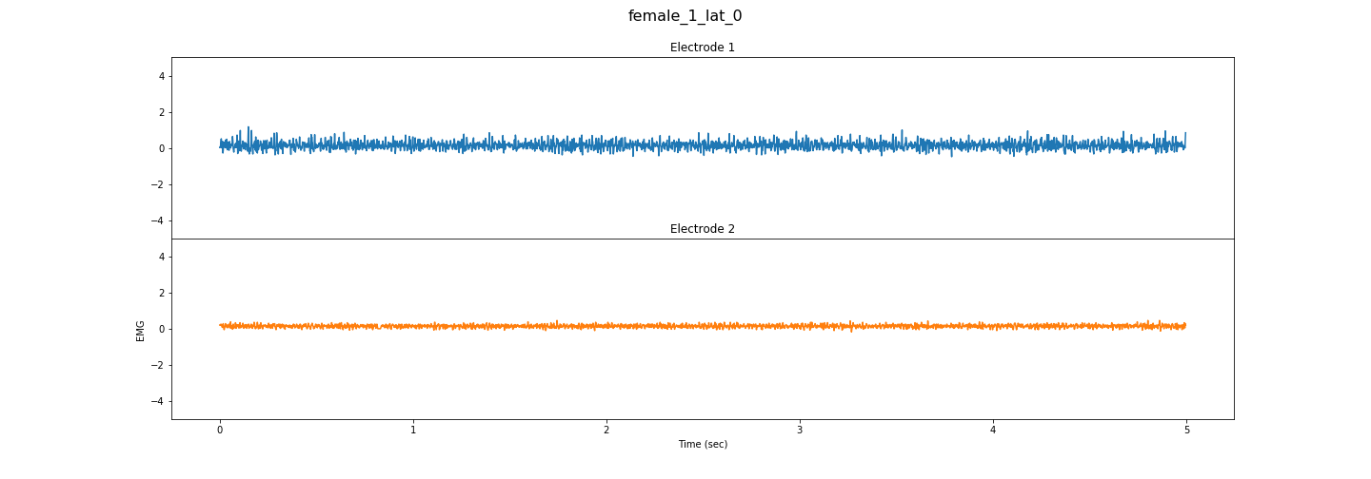
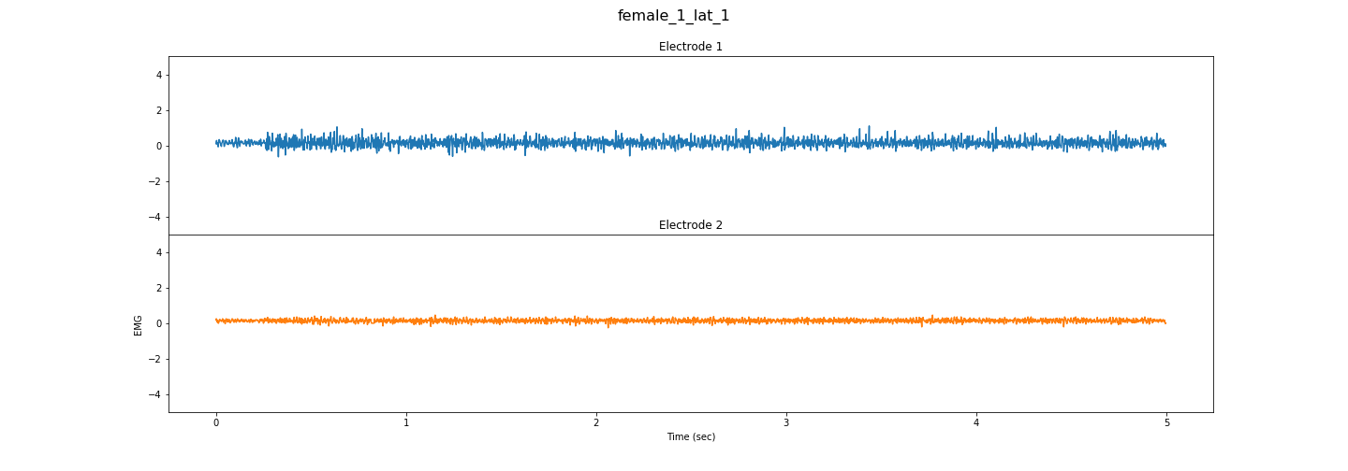
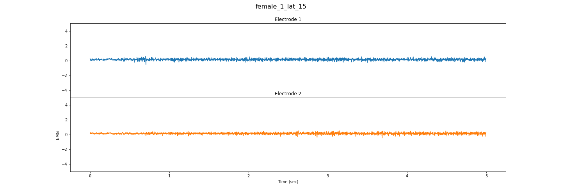
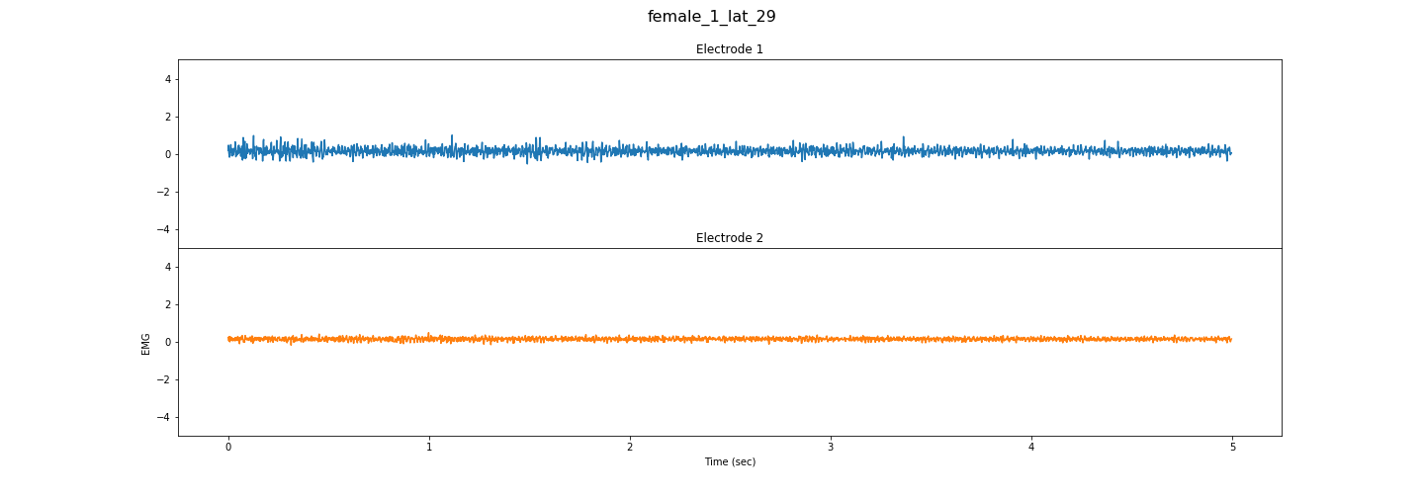
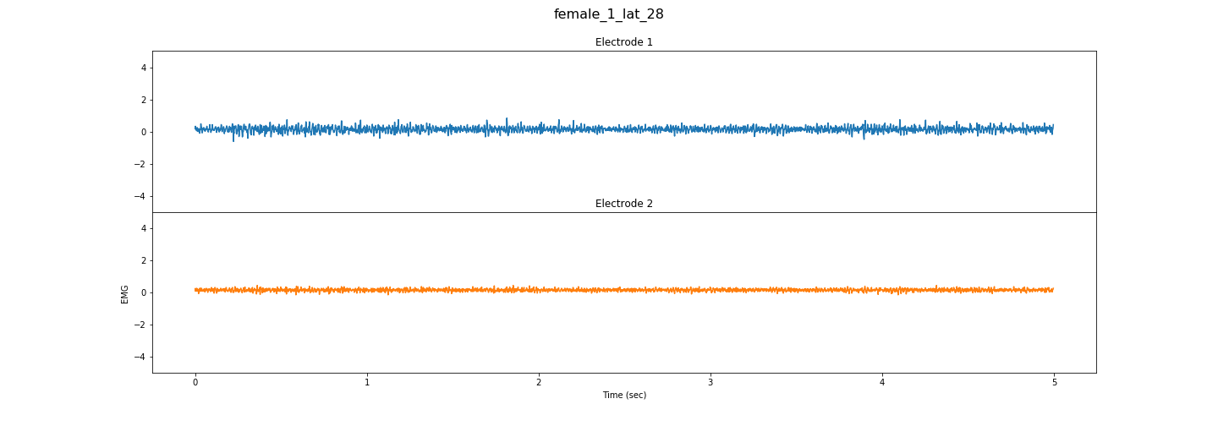

Slide 7
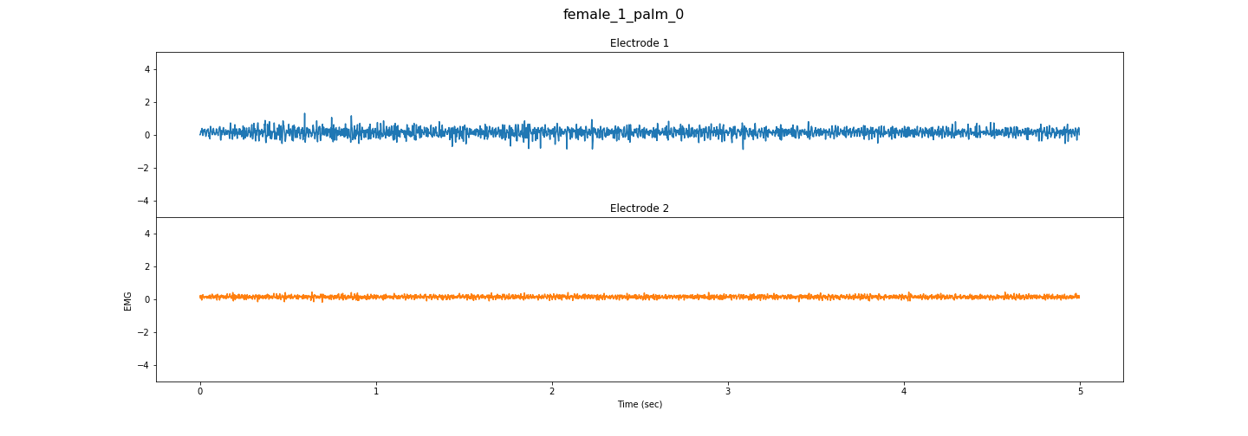
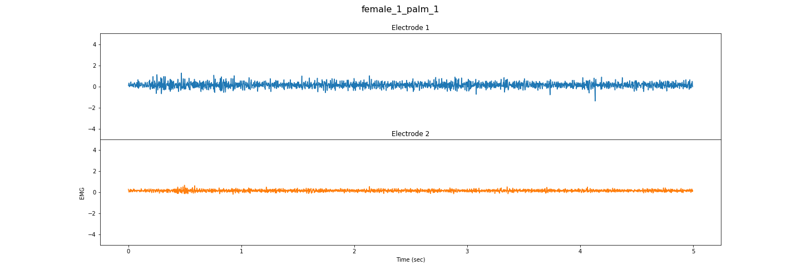
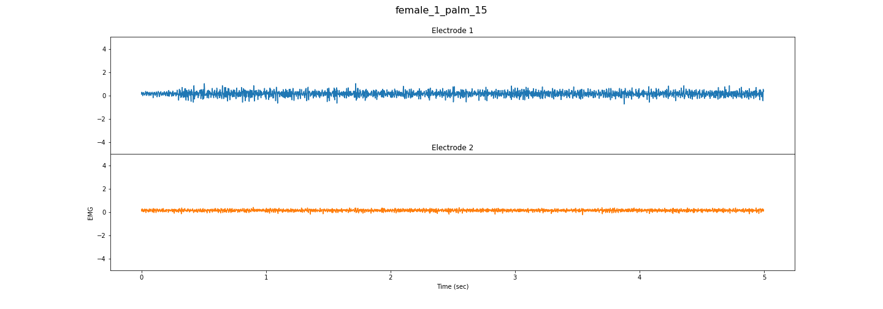
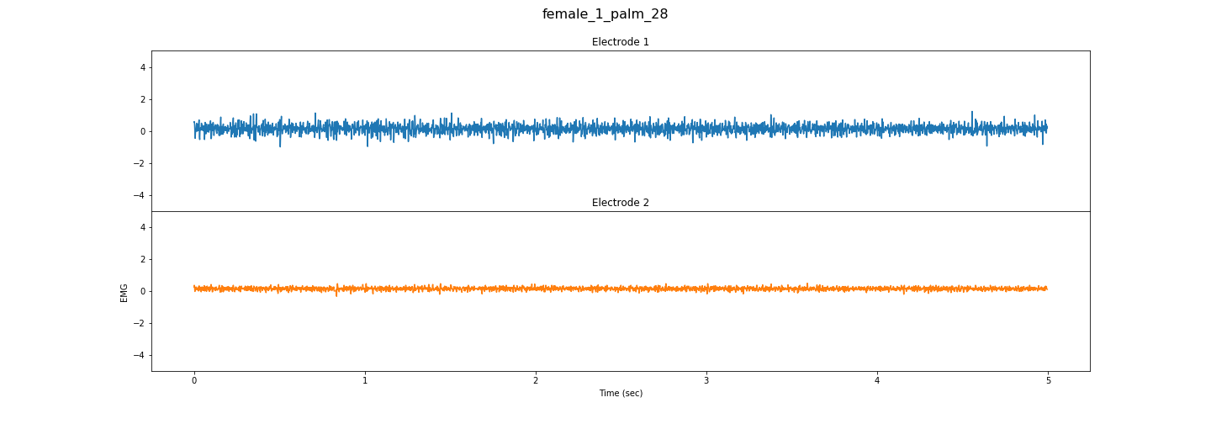
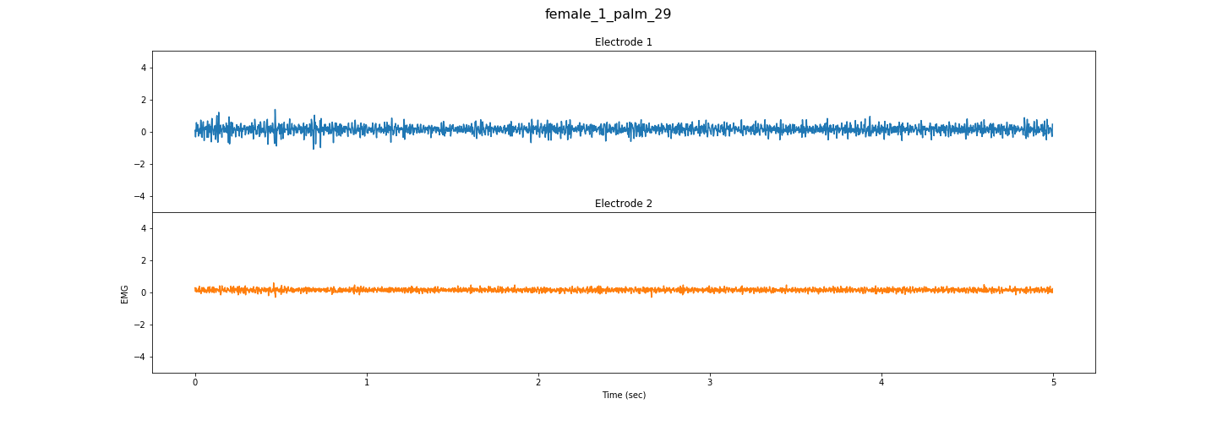

Slide 8
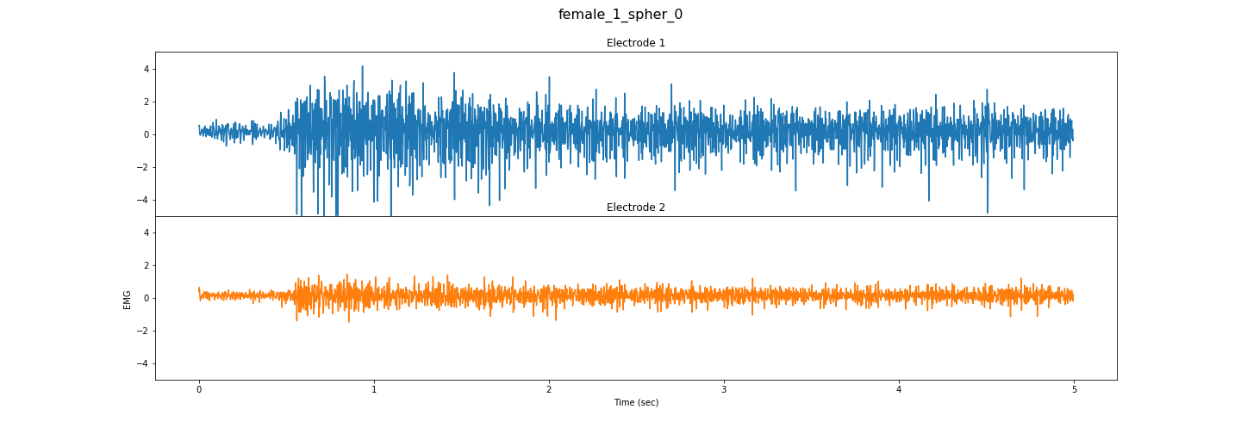
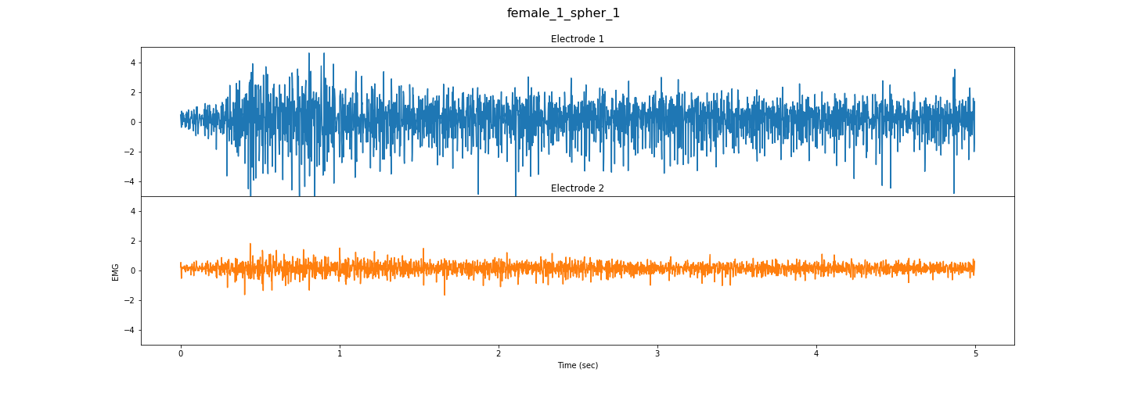
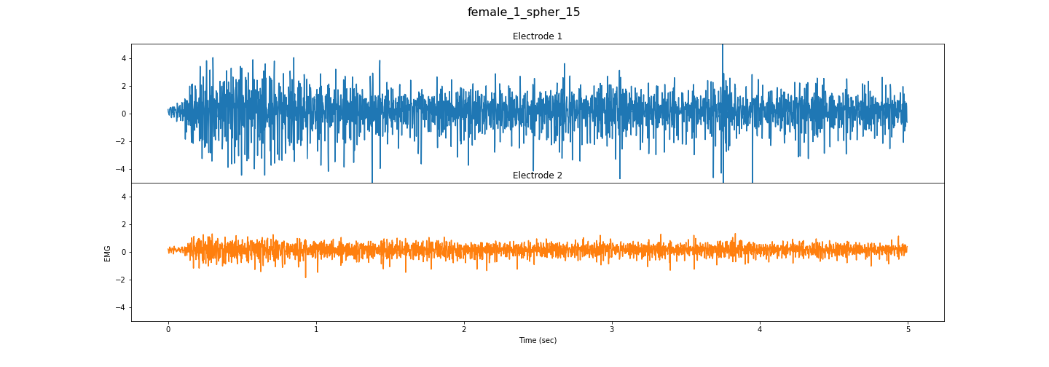
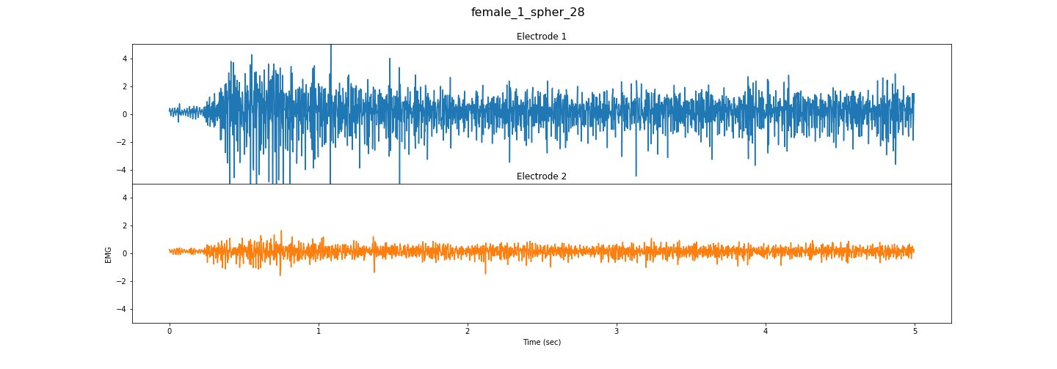
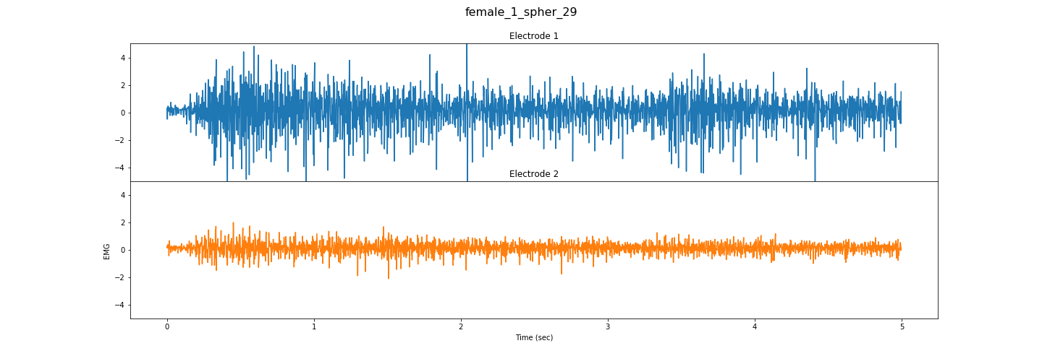

Slide 9
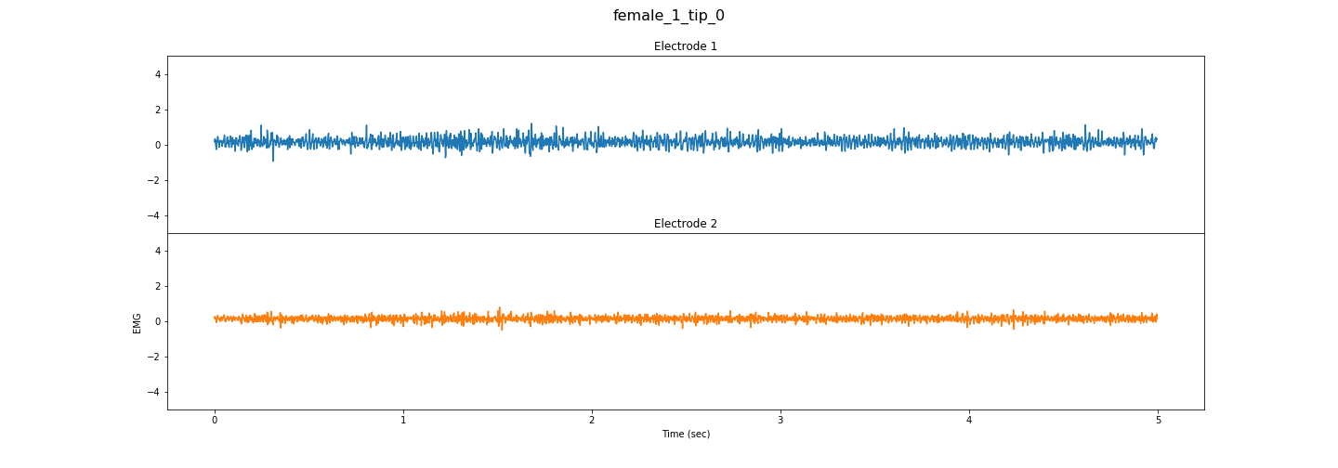
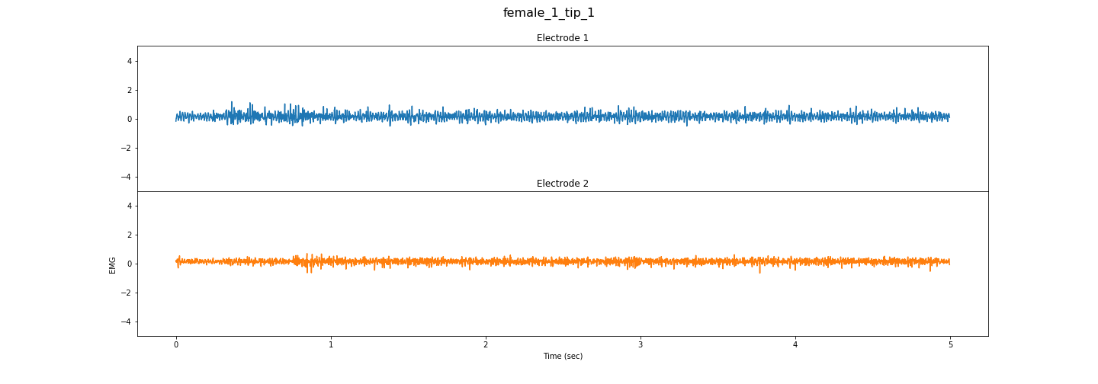
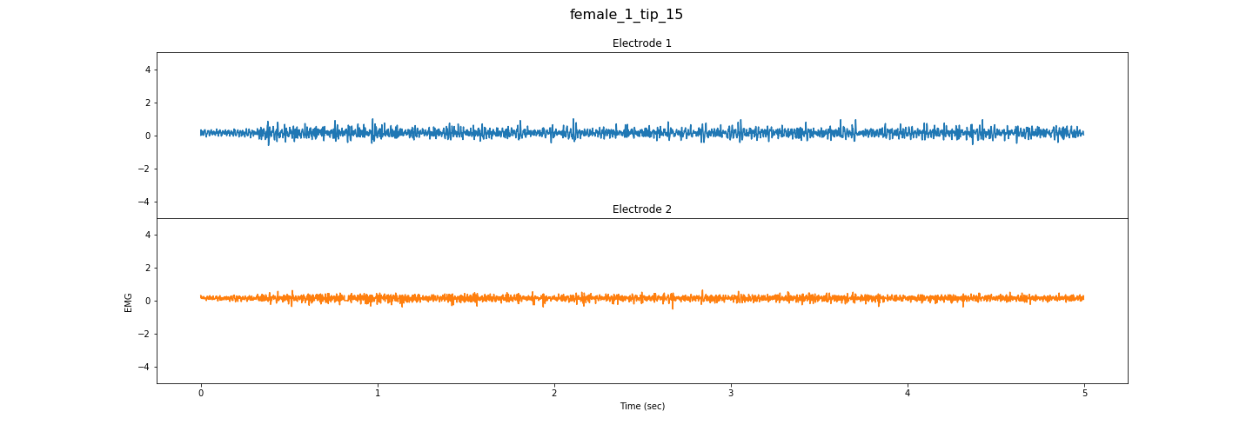
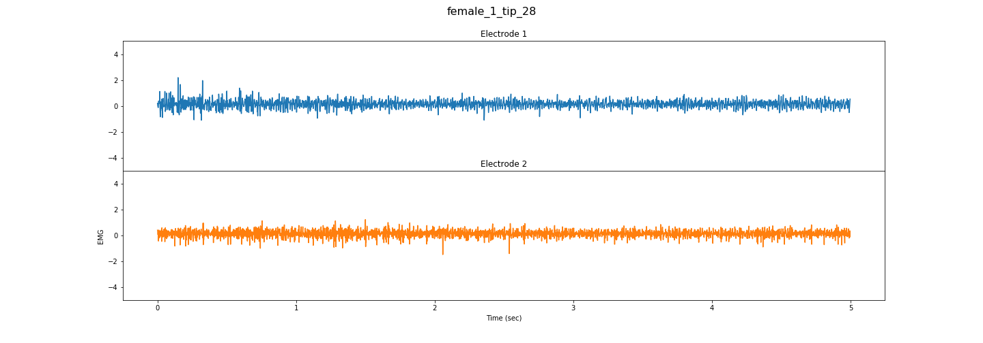
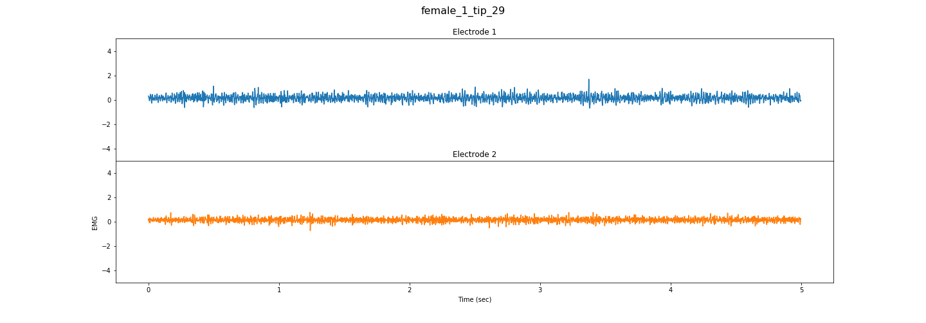

Slide 10
Single User Different Action Analysis
First Trial Of Each Action is plotted

Slide 12
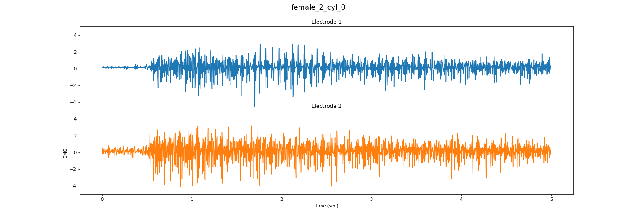
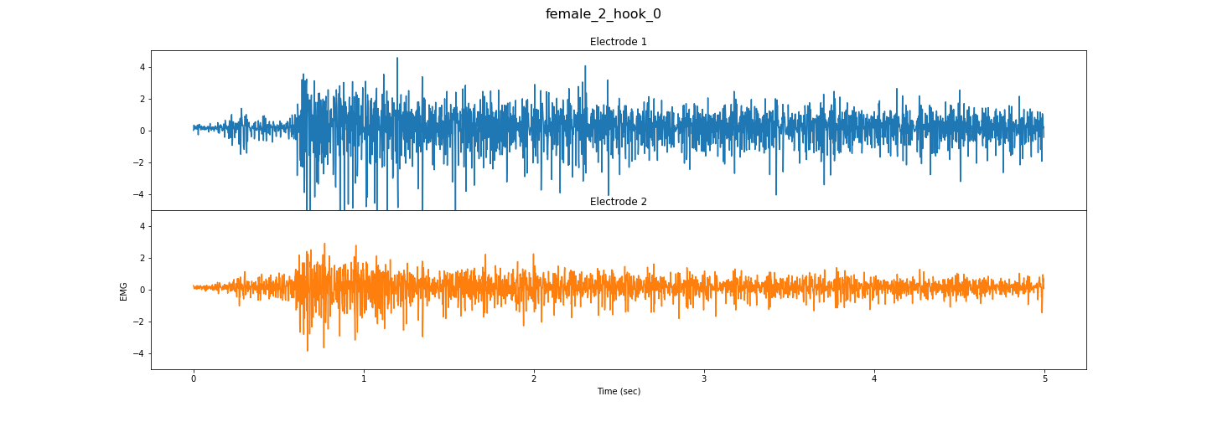
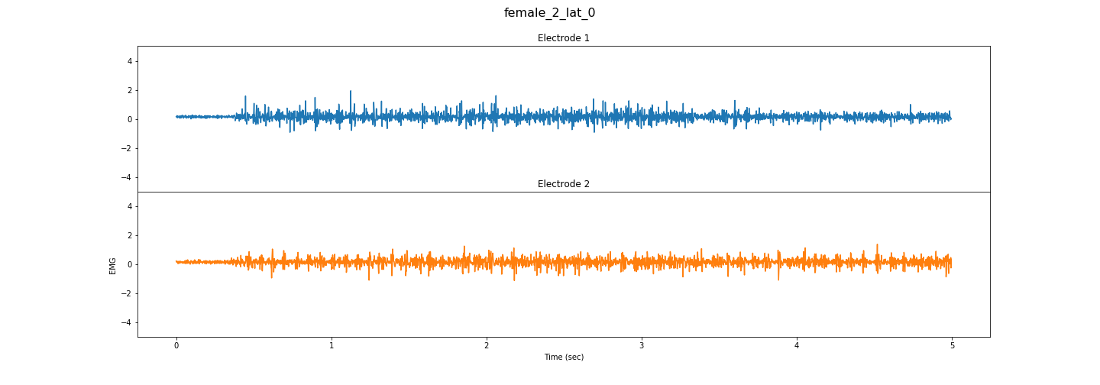
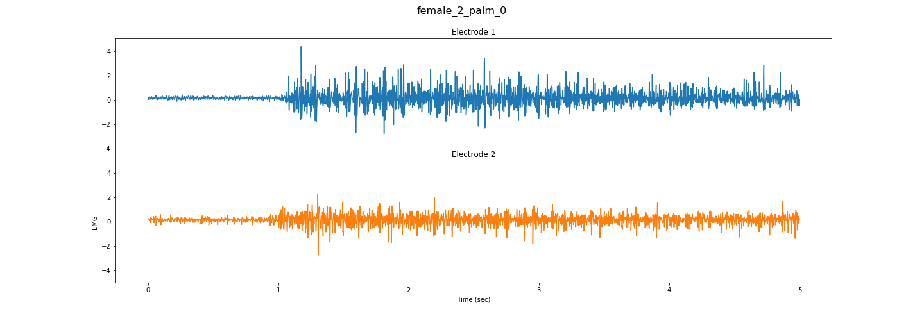
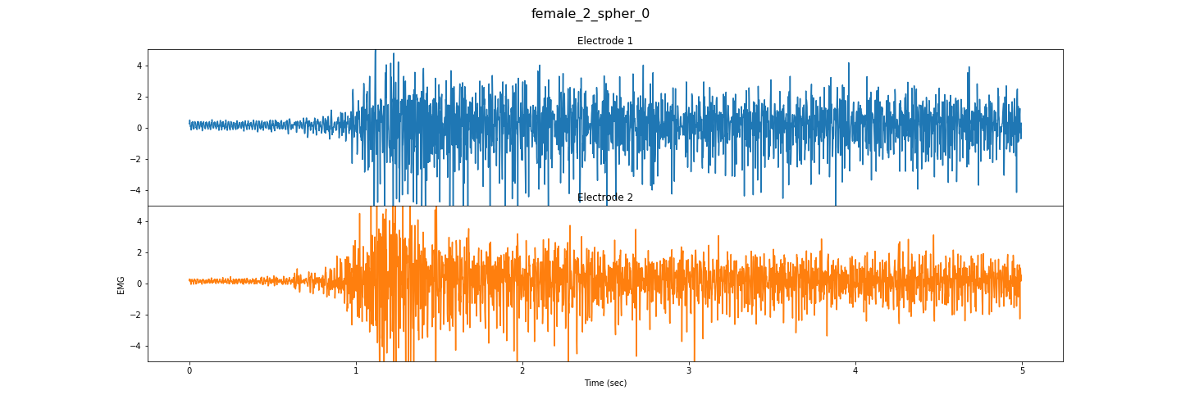
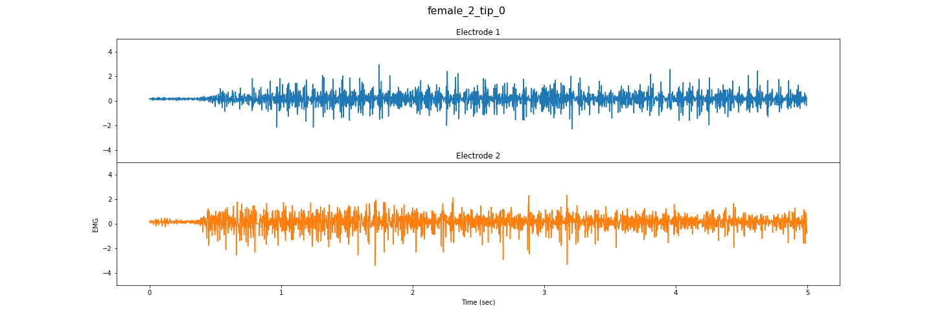

Slide 13
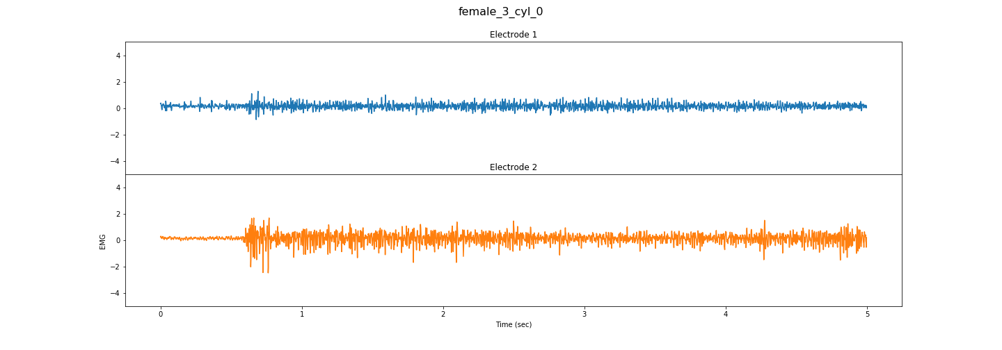
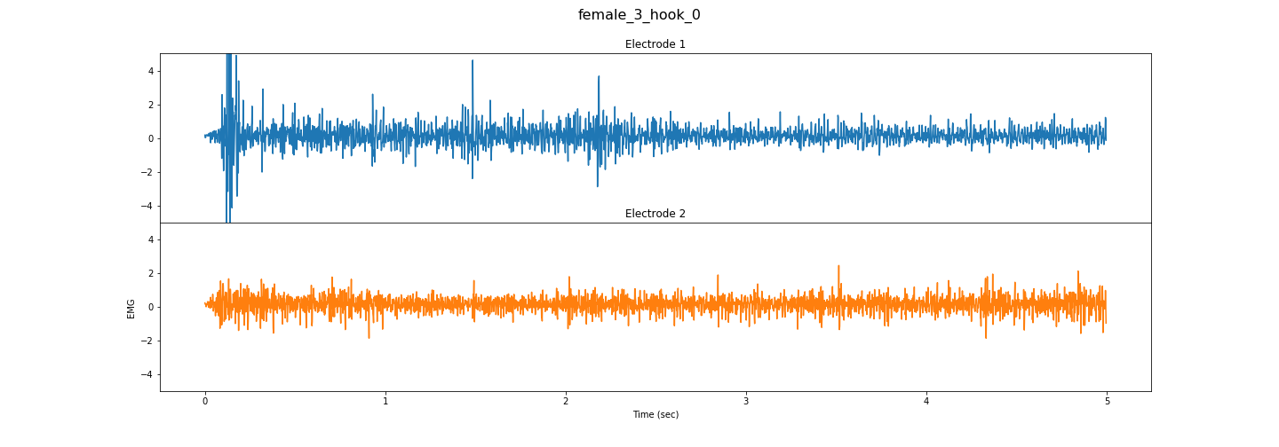
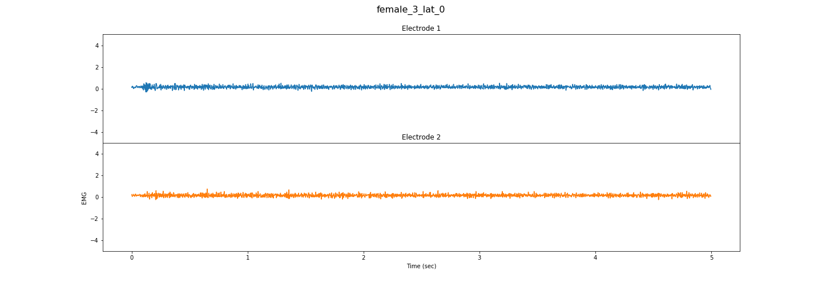
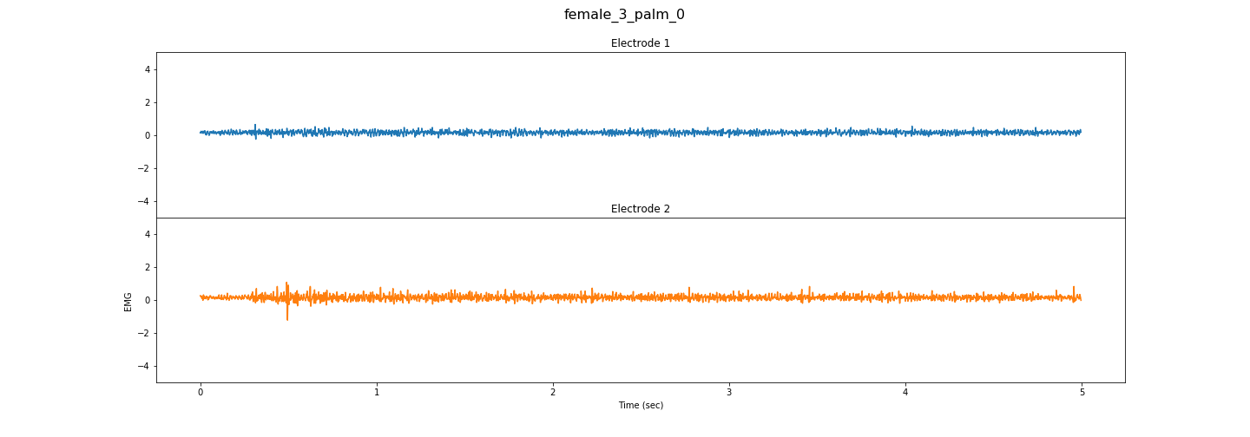
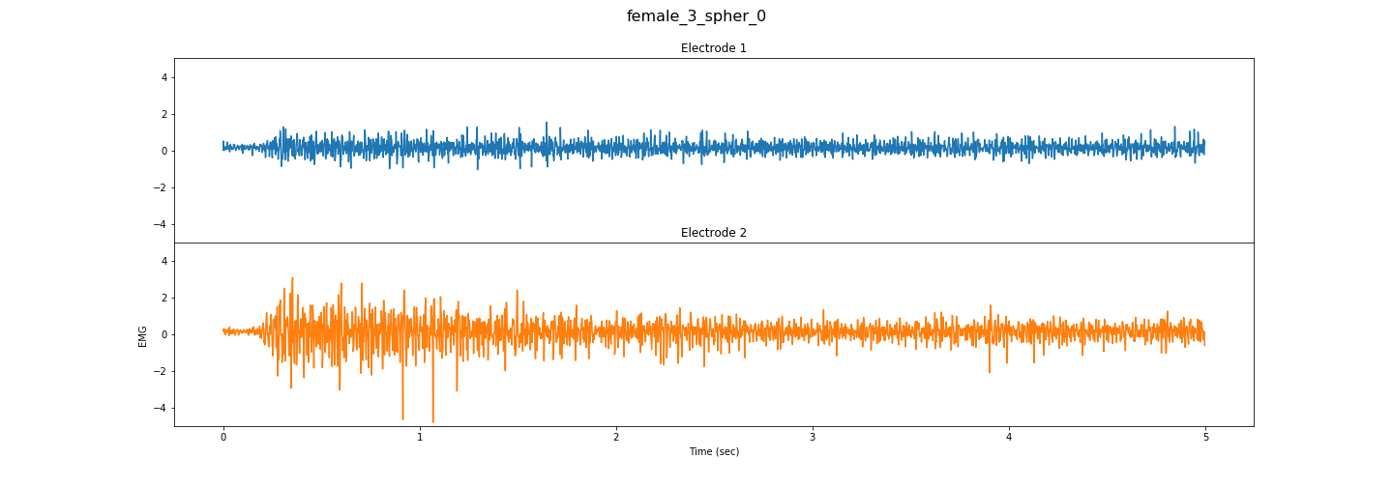
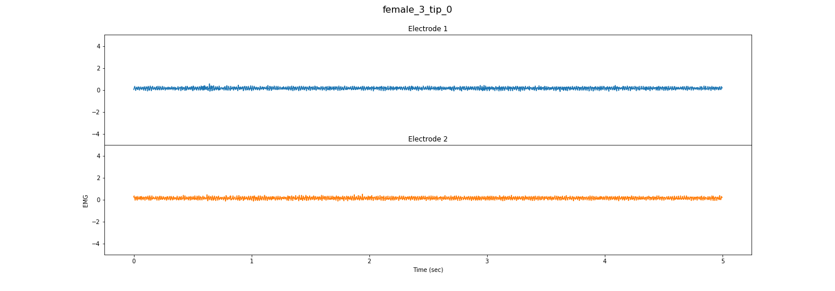

Slide 14
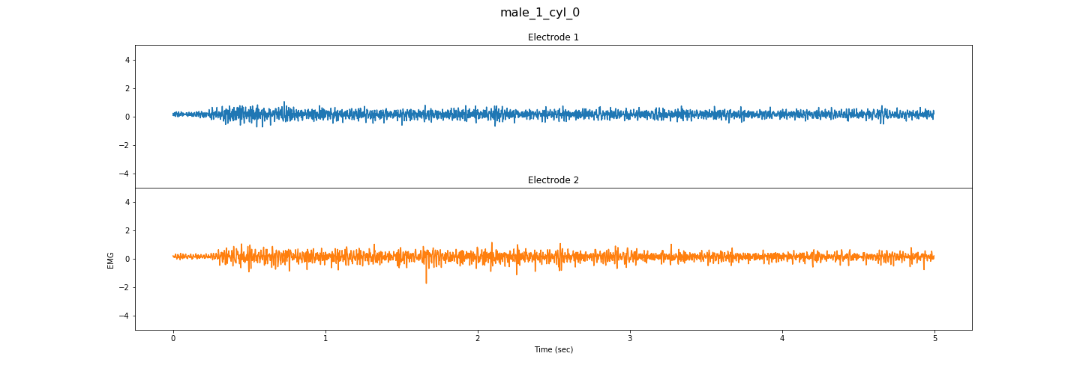
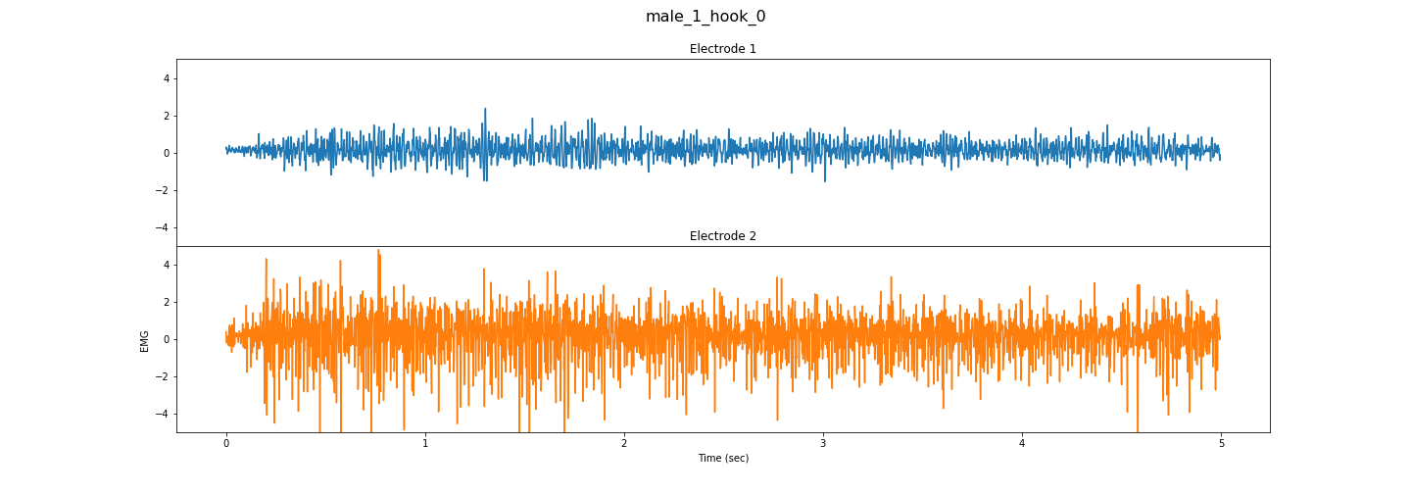
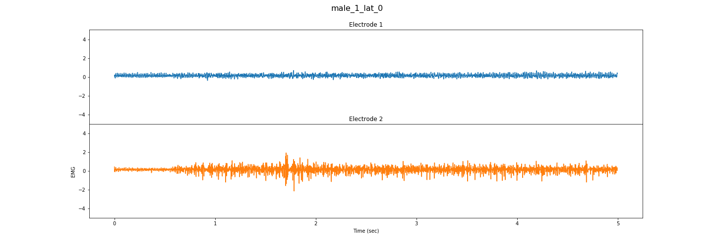
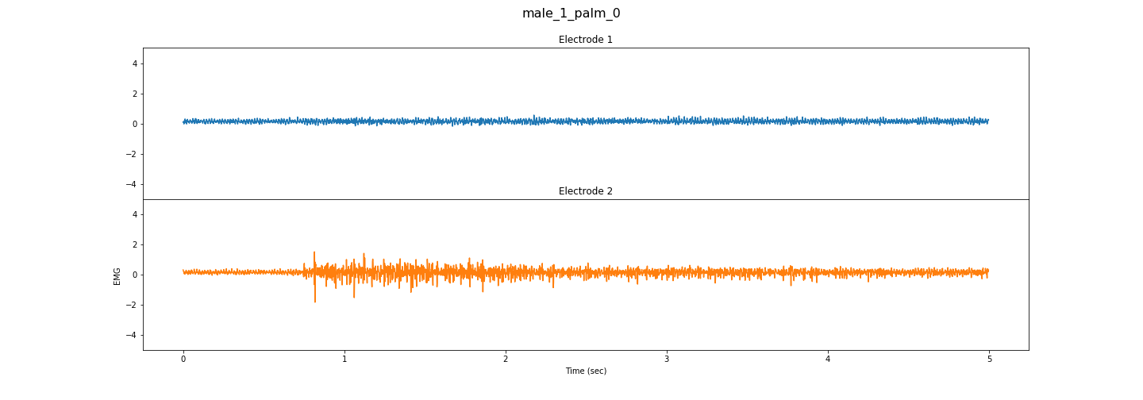
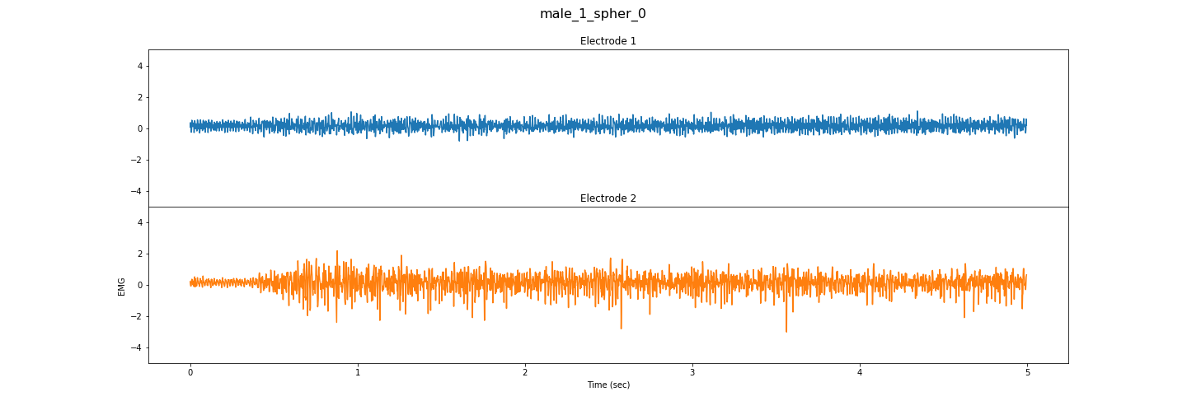
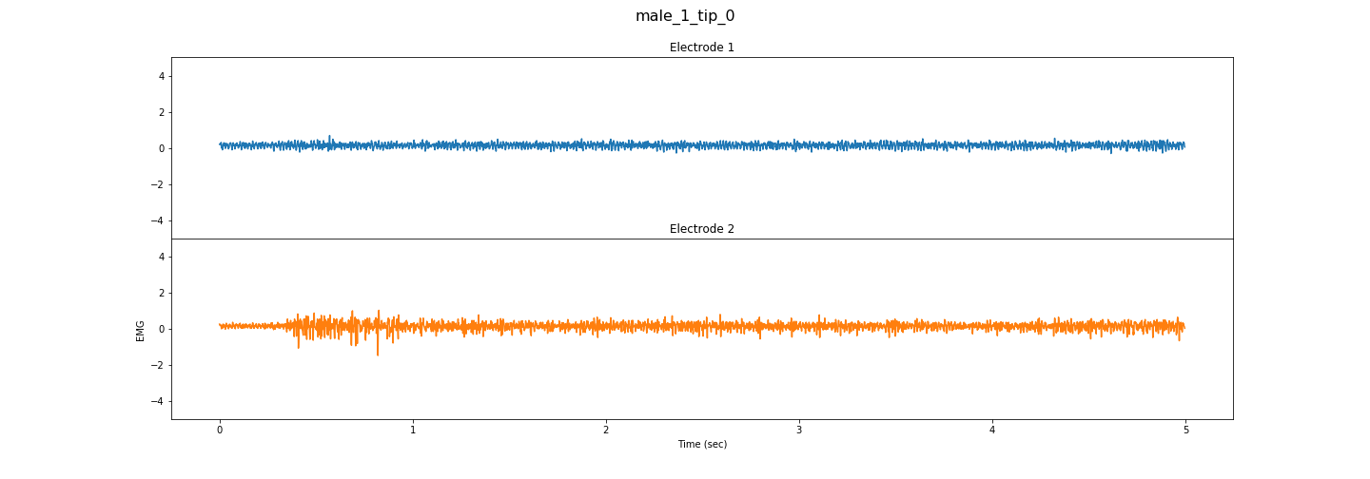

Slide 15
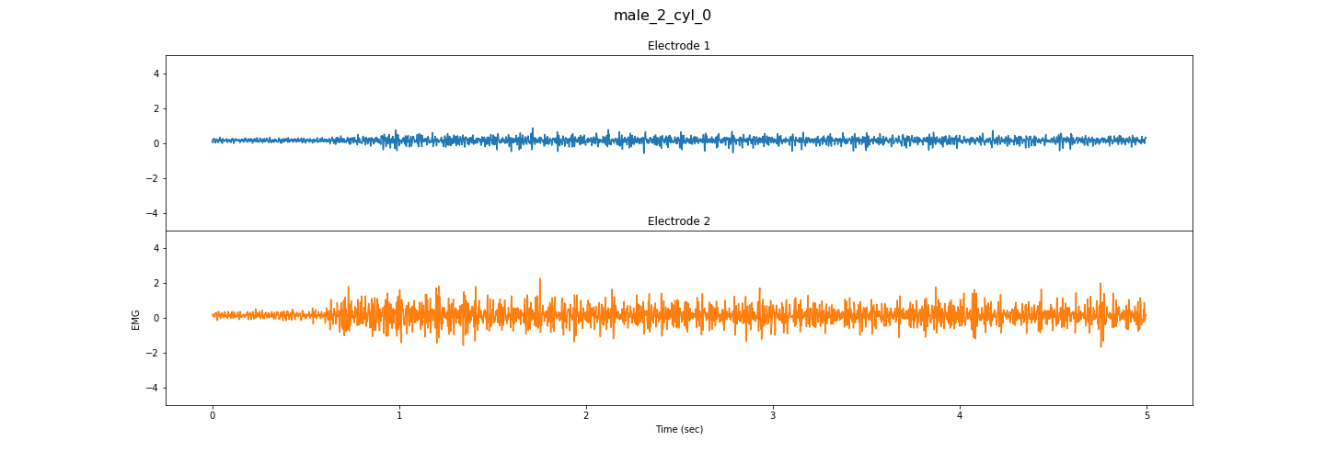
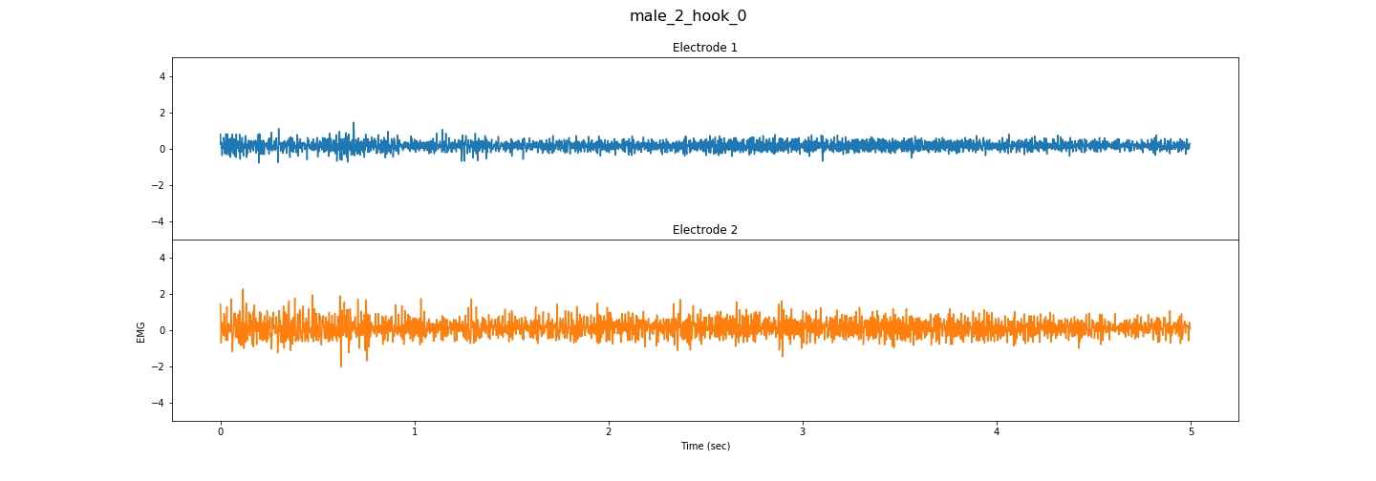





Slide 16
Different User Same Action Analysis
First Trial of each user is considered

Slide 23
Fast Fourier Transform

Slide 24
Single User Same Action Analysis
# Trials – 30
Trials plotted in below slides
Trial 1, 2, 15, 29,30

Slide 25






Slide 26






Slide 27






Slide 28






Slide 29






Slide 30






Slide 31
Single User Different Action Analysis
First Trial Of Each Action is plotted

Slide 33







Slide 34







Slide 35







Slide 36







Slide 37
Different User Same Action Analysis
First Trial of each user is considered

Slide 44
Time Domain Signal With Filter

Slide 45



Slide 46


Slide 47



